Slide 1
3d-Printed Granular Jamming Hand
Melissa Indoe
Chris Kang
Sean Phelan
Maggie Serra
Chris Wallace

Slide 2
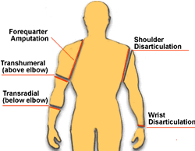
Project Background
About 12,500 new arm amputations happen every year
Most common reasons for arm amputation:
Trauma (77%)
Congenital (8.9%)
Tumor (8.2%)
Other diseases (5.8%)
Types of arm amputation:
Transcarpal (Some of the fingers)
Wrist Disarticulation
Transradial
Transhumeral
Shoulder Disarticulation
Forequarter Amputation

Slide 3
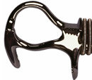
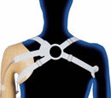
Project Background (continued)
Mechanical hands have existed for years
Run by cable attached to the shoulder
Open/closed by shrugging
Inaccurate motions
Poor ability to grasp irregularly shaped objects
Uncomfortable
Expensive
Commercially available myoelectric hands have existed for the last 5-10 years
Incredibly expensive
Heavy
2 to 3 times heavier than hook and cable
Uncomfortable

Slide 4
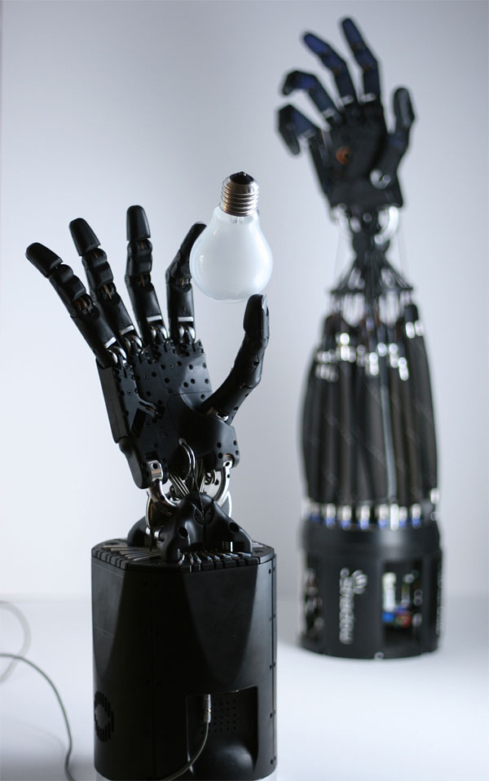
Project Objective
Create an open-source, affordable and high functioning prosthetic hand
The hand should be task-oriented and able to achieve household activities requiring relatively low strength and high dexterity
Major issues involved:
Maintaining dexterity
Keeping costs low
Durability

Slide 5
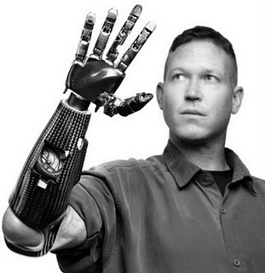
Societal Impact
Prosthetic
Able to improve quality-of-life for thousands of upper limb amputees
Affordable and approachable solution
Able to be used as hand analogs in hazardous situations
Handling of hazardous materials
Handling of babies in incubators
Manufacturing and automation
Open source
Able to be downloaded, edited and improved
by anyone, anywhere.

Slide 6
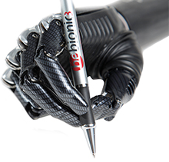
State-of-the-Art Designs
bebionic3 hand – used as human prosthesis
Individual Motors in each finger
Positioned to optimize weight distribution, making the hand feel lighter and more comfortable.
14 Selectable grip patterns and hand positions
Proportional Speed Control
precision control over delicate tasks, picks up an egg as easily as crushing an empty can.
Durable construction
strong enough to handle up to 45kg
Selectable thumb positions
Soft finger pads to enhance grip

Slide 7
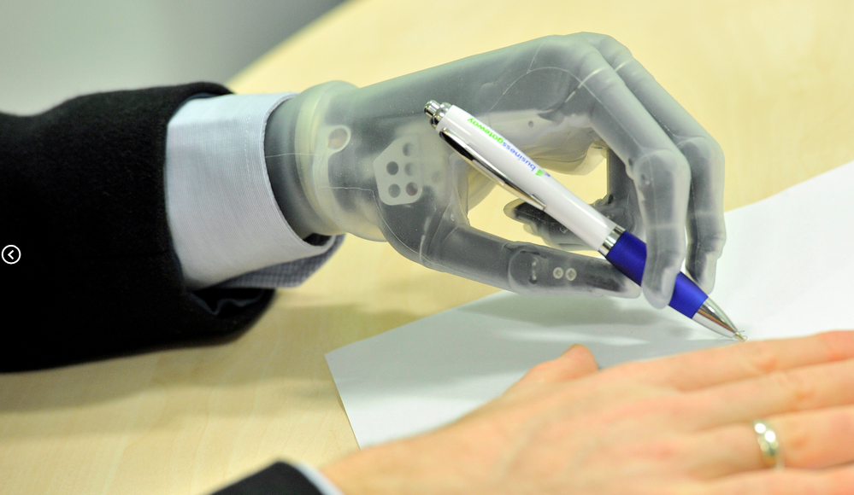
State-of-the-Art Designs
i-limb ultra revolution – used as human prosthesis
Powered rotating thumb
Five independently articulating digits with individual stall out ability. Each finger bends at the natural joints
A variety of flexible wrist options enabling more natural movement
Remote electrodes are
waterproof, low profile,
and gold-plated for higher
sensitivity
Battery powered

Slide 8
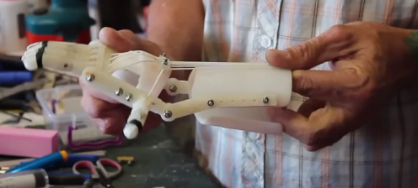
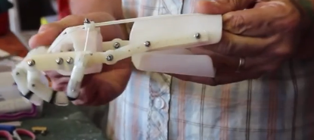
Existing Open-Source Designs
RoboHand
Completely 3D printed except for three components
Bend wrist down to close fingers
Bend wrist up to release grip
Designed for people with no fingers

Slide 9
Existing Open Source Designs
InMoov
3D printed by a hobbyist
Uses cables driven by motors for motion

Slide 10
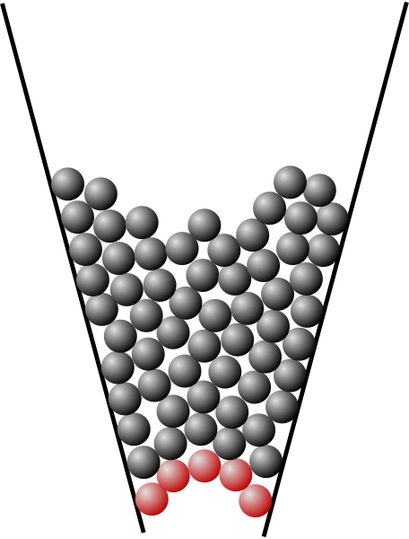
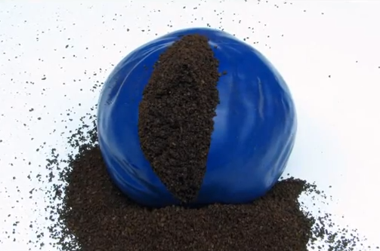
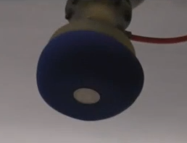
Granular Jamming
Jamming –a physical process by which some materials, such as granular materials become rigid with increasing density.
Coarse substance in a flexible casing is soft until air is removed
Example: Coffee grounds in a balloon
This can be used to pick up, grip, or throw objects
Notes:
When particles are not jammed, they are able to flow past each other. When jammed, the group of particles becomes more rigid, like how sand can be poured, but is still able to support your weight when you stand on it.
The planned design will make use of this by having pads of granular material along the palm of the hand, and then forcing the granules to jam by sucking the air out of the sac.

Slide 11
Granular Jamming In Action

Slide 12
Conceptual Designs
To simplify the design process, brainstorming was split into categories:
Category 1: Hand Ideas
Ideas relating to the rigid components of the hand
Category 2: Granular Jamming Ideas
Ideas relating to the granular jamming pads
Category 3: Other Considerations
These were ideas or requirements that did not fit into any one category

Slide 13
Hand Ideas
Joint ideas
Ways to move joints
Pneumatics
Motors (one per joint)
Cables
One cable per finger
One cable per finger, share cable for ring and pinky
One cable per joint per finger
One cable for 2 joints per finger
Motors and cables (motors at finger base)
Ideas to hold position
Gear teeth at joint interface
External joint locks

Slide 14
Hand Ideas (continued)
Straightening out the hand
Long rubber bands
Dental rubber bands
Flat springs
A second set of cables
Sensing grip
No grip sense: vacuum activated by button
Place bump sensor under granular jamming pad
Place encoder on servo motor, see if servo is stalled

Slide 15
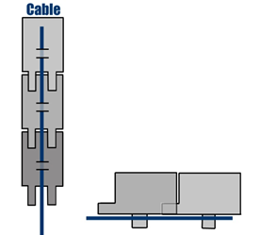
Joint Ideas Decision Matrix
Category: | Simplicity | Affordability | Size | Range of Motion | Totals:
Category Weight: | 10 | 8 | 10 | 8
Item:
Pneumatics | 2 | 4 | 3 | 6 | 130
Motors (1/joint) | 1 | 1 | 1 | 10 | 108
Cables | 9 | 9 | 9 | 7 | 308
Motors & Cables | 6 | 7 | 5 | 8 | 230

Slide 16
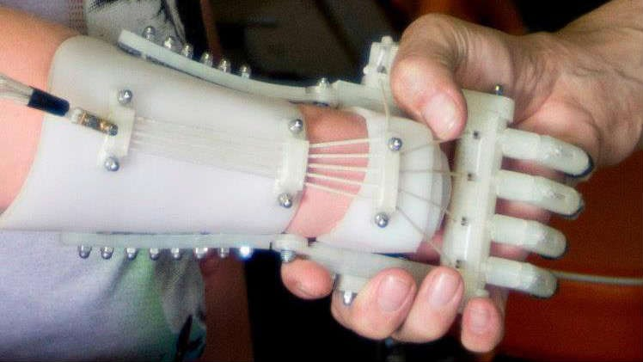
Cabling Ideas Decision Matrix
Category: | Simplicity | Affordability | Range of Motion | Totals:
Category Weight: | 10 | 8 | 8
Item:
5 Cables (1/Finger) | 9 | 9 | 7 | 218
4 Cables | 9 | 10 | 5 | 210
1 Cable/Joint | 2 | 2 | 9 | 108
1 Cable/2 Joints | 4 | 4 | 8 | 136

Slide 17
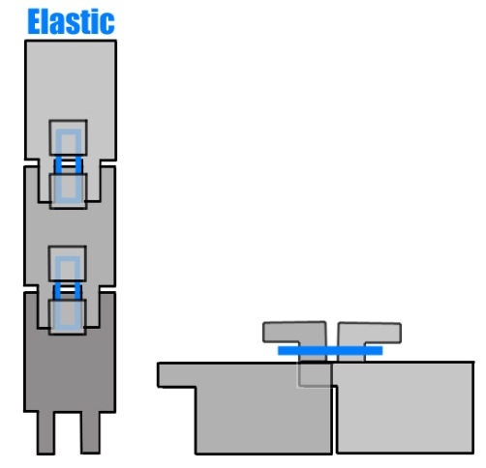
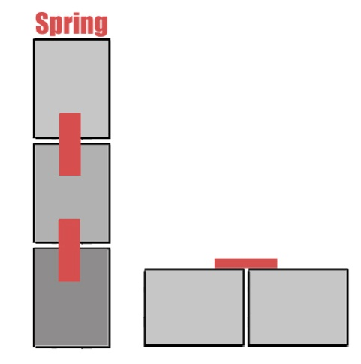
Hand Straightening Ideas Decision Matrix
Category: | Simplicity | Affordability | Reliability | Repairability | Range of Motion | Totals:
Category Weight: | 10 | 8 | 7 | 6 | 8
Item:
Long Rubber Bands | 8 | 9 | 4 | 2 | 7 | 248
Dental Rubber Bands | 6 | 9 | 5 | 9 | 7 | 277
Flat Springs | 8 | 6 | 9 | 5 | 7 | 277
Second Set of Cables | 4 | 2 | 8 | 7 | 9 | 226

Slide 18
Grip Sense Decision Matrix
Category: | Simplicity | Affordability | Reliability | Repairability | Usability | Totals:
Category Weight: | 10 | 8 | 7 | 6 | 10
Item:
Vacuum Button | 9 | 9 | 9 | 9 | 1 | 289
Bump Sensor | 4 | 4 | 3 | 2 | 10 | 205
Encoder Boards | 8 | 8 | 8 | 8 | 9 | 338

Slide 19
Granular Jamming Ideas
Granular Jamming Material
Sand
Coffee grounds
Plastic stuffing materials
Housing Material
Balloons
Silicone
Layout
Interconnected pads
Pad for fingertip
Pad for all three finger sections
Pad for only fingertip and base sections
Individual pads

Slide 20
Granular Jamming Decision Matrices
Layout of Pads
Category: | Simplicity | Affordability | Feasability | Totals:
Category Weight: | 10 | 8 | 9
Item:
Interconnected | 9 | 8 | 7 | 217
Individual | 5 | 6 | 3 | 125
Housing Material
Category: | Simplicity | Affordability | Feasability | Totals:
Category Weight: | 10 | 8 | 9
Item:
Balloon | 8 | 10 | 7 | 223
Silicone | 9 | 9 | 8 | 234

Slide 21
Preliminary Testing
To see which parts of the hands were most frequently used, some simple tests were conducted
Household items were coated in chalk and then manipulated
This showed in chalk where the hand had contacted the object
Conclusion:
Mainly the fingertips and palm were used
This was then used to determine the value of individual granular jamming pads (i.e. which were most important to keep)
Other testing will also be done to determine the best granular jamming material

Slide 22
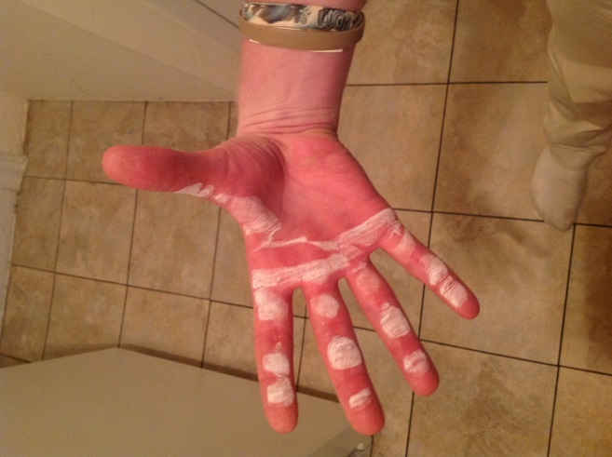
Preliminary testing (continued)

Slide 23

Preliminary testing (continued)

Slide 24
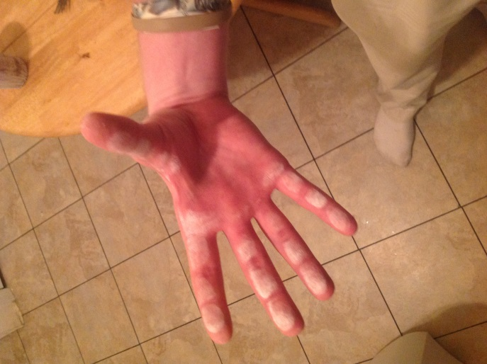
Preliminary testing (continued)

Slide 25

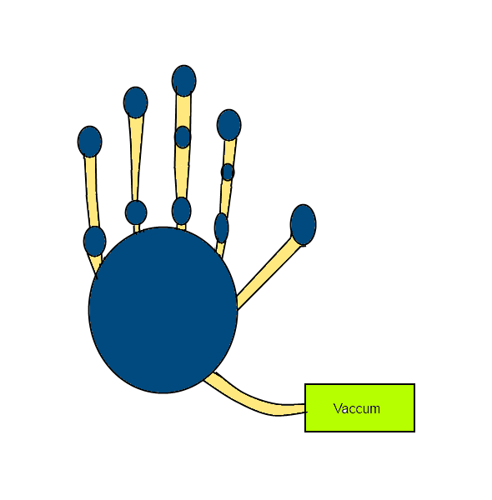
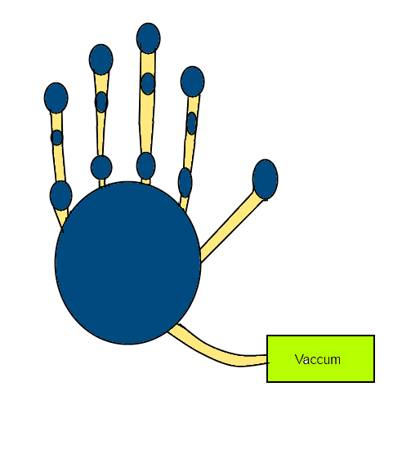
Layout Design Comparison
Layout of Granular Jamming Pads
Pad in each length
Pads on 3 segments for index and middle

Slide 26
Other Considerations
Polycarbonate plastic
Making the product out of polycarbonate plastic means that it will be much stronger than most available 3d printed plastic
Use with touch screens
Conductive fabric can be added to the index finger and thumb to allow its use with smartphones
Nails
Nails are used for certain tasks (such as opening cans)
Adding prosthetic “nails” to the project will add a little functionality
Size
Hand must follow roughly the same size of a real human hand, and cannot be much heavier

Slide 27
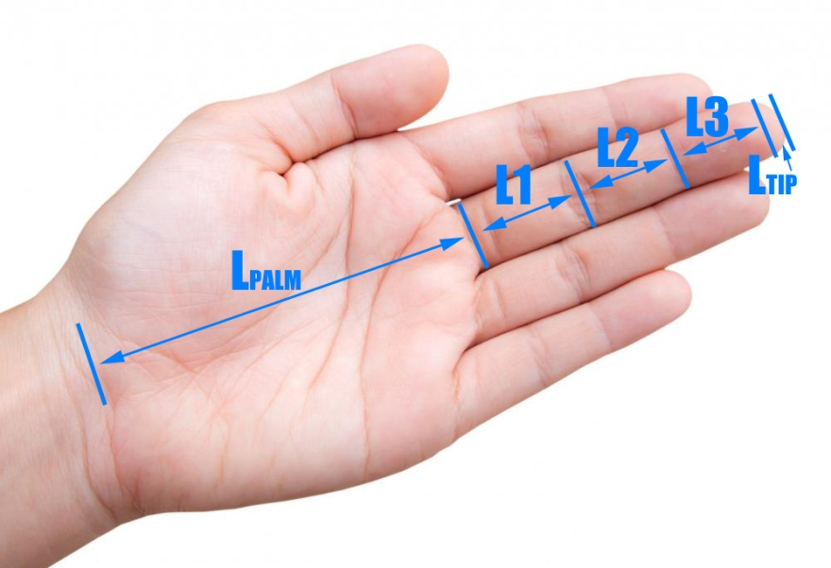
Hand Size
Important to match size of an average hand
Hand segment lengths (middle finger):
L1 = 44.6 mm
L2 = 26.3 mm
L3 = 17.4 mm
Ltip = 3.95 mm
Lpalm = 88.2 mm
Palm Width = 79 mm
Finger Width= 19.75 mm

Slide 28
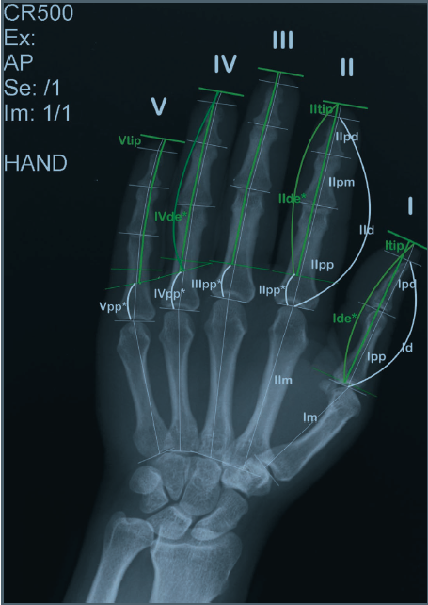
Hand size (continued)
Weight of the hand = 425.7 g
Weight of hand & forearm = 1,699.1 g
Finger length ratios:
Index = 0.8*(Middle Length)
Ring Length = 0.93*(Middle Length)
Pinky Length = 0.74*(Middle Length)

Slide 29
Conceptual Design
Primary hand design:
Run by 5 cables attached to motors in the forearm
Hand will be kept straight via dental rubber bands or flat springs
(If there is time, both will be tested)
Grip will be sensed via encoders tracking each motor
Emulate the size and weight of an average human hand
Secondary goals:
Wrist motion
Locking joints
Use with touchscreens
Accurate finger length ratios
Nails

Slide 30
Areas For Technical Analysis
Granular jamming housings and materials
Physical tests of granular jamming pads to see what materials are most appropriate
Granular jamming requirements
What is the minimum vacuum force needed for effective jamming
Forces on joints
Design considerations needed to avoid snapping of the plastic
Generate models to see if joint pins can be printed or should be metal
Determine whether or not ABS or PLA plastics may be used

Slide 31
Engineering Design
Method
1st : prototype so that software and device are ready. Then choose which sensor to measure signals from patients (e.g. EEG)
Attachment to forearm
Ease of attaching as well as detaching the device (e.g. around shoulders)
Device cannot be too heavy for a person to carry
Granular jamming
Fabrication/wear must be in consideration
Housing and material have to be reliable and convenient for everyday use
Hand grip force
Battery usage can be known for motors and vacuum for granular jamming system

Slide 32
Budget
Part | Quantity | Cost | Total
dyIO | 1 | 75.00 | $75.00
Polycarbonate 3mm Filament | 1 | 74.99 | $74.99
Natural ABS 3mm Filament | 1 | 37.95 | $37.95
10 piece rotary encoder set | 1 | 10.00 | $10.00
Servo Motor | 7 | 8.95 | $62.65
25 1/4th inch stainless steel screws | 1 | 6.49 | $6.49
30 pack Small Ball Bearings | 1 | 14.95 | $14.95
30 bag 5/16" rubber bands | 1 | 4.95 | $4.95
VEX Robotics NiMH Robot Battery | 1 | 19.99 | $19.99
6' Silicone Air Line Tubing | 1 | 3.33 | $3.33
1 pint Platex Mold Latex | 1 | 36.00 | $36.00
Detailed Plastic Acrylic based | 5 | 2.99 | $14.95
Air Pincette Vacuum Tweezers | 1 | 75.00 | $75.00
Total Price |  |  | $436.25

Slide 33
Deliverables at end of Semester
OpenSCAD will be used to finalize design and create a complete prototype of the device in Phases II and III.
Complete technical analysis
Testing of designs and interfaces
Website design
Finalized Bill of Materials
Gain significant knowledge in the materials, robotics, and biomechanics fields
Understand and address the impact of the design in ethical, environmental, social, political, health and safety, sustainability, standardization/standards context

Slide 34
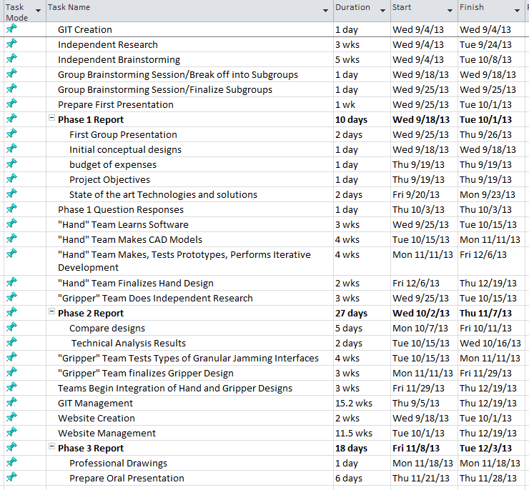
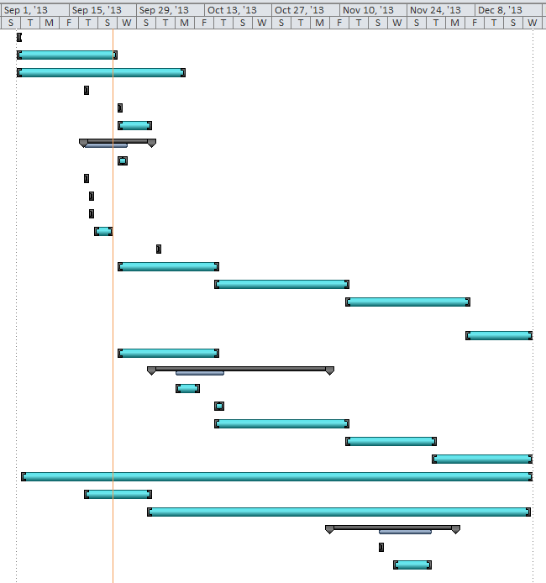
Gantt chart

